Slide 1

Automotive Technology: A Systems Approach, 8e
Chapter 24: Engine Performance Systems
Rob Thompson and Jack Erjavec, Automotive Technology: A Systems Approach, 8th Edition. © 2025 Cengage. All Rights Reserved. May not be scanned, copied or duplicated, or posted to a publicly accessible website, in whole or in part.

Slide 2
Chapter Objectives (1 of 3)
24.01 State the purpose of the major engine performance systems/components.
24.02 Describe the purpose and operation of the ignition system. Explain how fuel injection systems operate. Describe the components and operation of the air induction system.
24.03 Explain the purpose of the emission control system.
24.04 Describe how computer systems use inputs and outputs for engine control.

Slide 3
Chapter Objectives (2 of 3)
24.05 Describe how the computer system is used to control non-engine-related functions.
24.06 Explain the purpose of Onboard Diagnostic Systems.
24.07 Describe OBD II operation.
24.08 Briefly describe the monitored systems in an OBD II system.

Slide 4
Chapter Objectives (3 of 3)
24.09 Describe the self-diagnostic capabilities of OBD II. Define the MIL and what types of data are available. Diagnose the causes of emissions or driveability concerns resulting from malfunctions in the computerized engine control system with stored diagnostic trouble codes.
24.10 Obtain and interpret scan tool data.

Slide 5
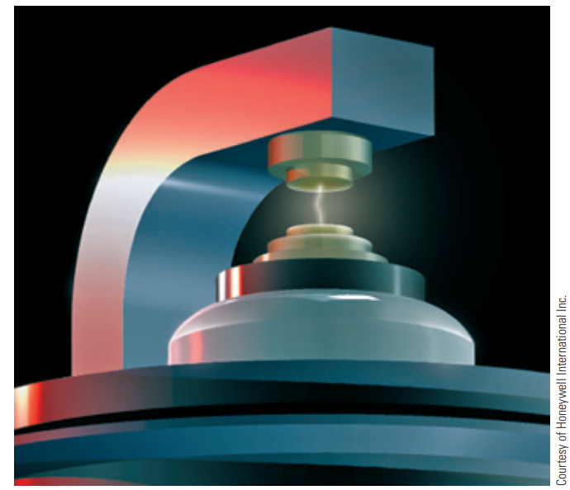
Ignition Systems (1 of 2)
24.01 State the purpose of the major engine performance systems/components.
For complete combustion, the ignition system must supply properly timed, high-voltage surges across the spark plug electrodes at the proper time under all engine operating conditions.
These plug firings must also occur at the correct time and generate the correct amount of heat.
There are basically two types of ignition systems: distributor ignition (DI) and electronic ignition (EI) or distributorless ignition systems (DIS).

Slide 6
Ignition Systems (2 of 2)
Purpose of the Ignition System for each cylinder, the ignition system has three primary jobs:
  It must generate an electrical spark with enough heat to ignite the air–fuel mixture in the combustion chamber.
  It must maintain that spark long enough to allow total combustion of the fuel in the chamber.
  It must deliver the spark to each cylinder to allow combustion to begin at the right time during the compression stroke.

Slide 7
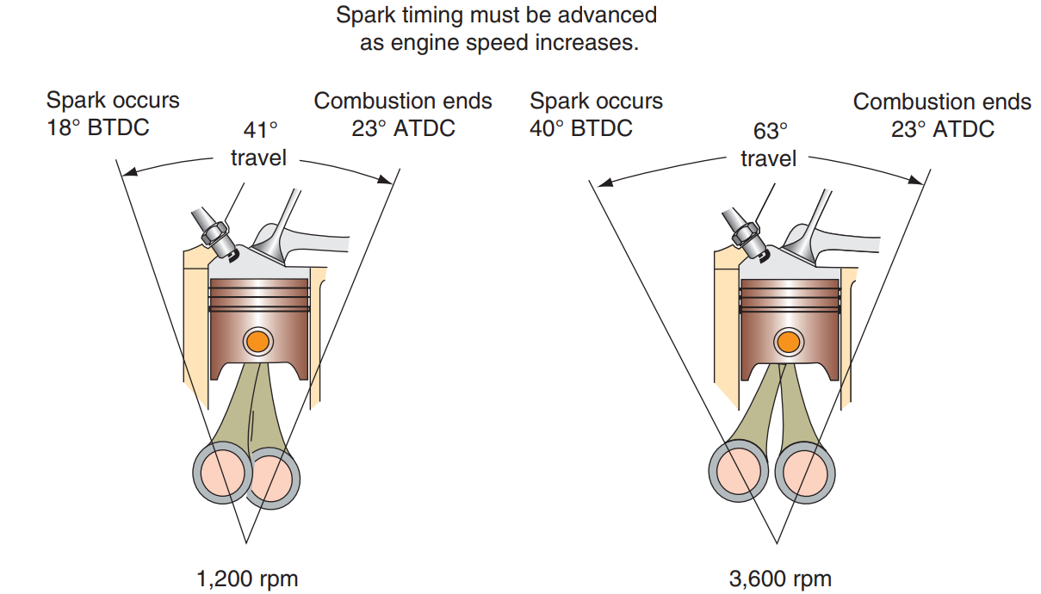
Ignition Timing
Ignition timing refers to the precise time spark occurs and is specified by referring to the position of the number 1 piston in relation to crankshaft rotation.
Engines with distributor ignition systems have ignition timing reference marks located on a pulley or flywheel to indicate the position of the number 1 piston at TDC on the compression stroke.
This reference is used to set initial ignition timing. For those engines, the manufacturers typically list an initial or base ignition timing specification.
Timing may be advanced, meaning that the process to generate the spark occurs sooner as engine speed increases.

Slide 8
Firing Order
The spark for all cylinders must be delivered at the right time.
How the ignition system does this depends on the design of the system.
The firing order is the sequence in which each spark plug ignites the air–fuel mixture in the cylinders.
Each engine has a mechanical sequence of valves opening and closing as the pistons move up and down.
The sequence defines when each cylinder produces power.
The firing order corresponds to each cylinder as it moves through the compression stroke.
If the spark occurs at any time other than during the end of the compression stroke, performance will be affected.
With a distributor system, the firing order follows the placement of the ignition wires along the distributor cap.

Slide 9
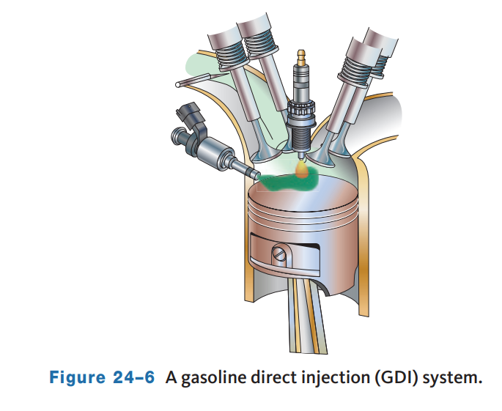
Fuel Injection
Electronic fuel injection (EFI) has proven to be the most precise, reliable, and cost-effective method of delivering fuel to the combustion chambers of today’s engines.
EFI systems are computer controlled and designed to provide the correct air–fuel ratio for all engine loads, speeds, and temperature conditions.
Most engines are now equipped with gasoline direct-injection (GDI).
In these systems, the fuel is injected directly into the cylinders.
Most EFI systems only inject fuel during the engine’s intake cycle.

Slide 10
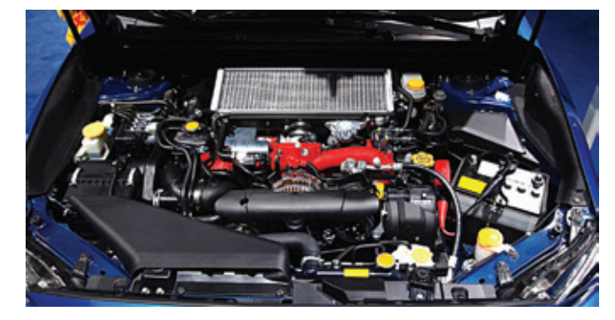
Air Induction System
An internal combustion engine needs air to run.
This air supply is drawn into the engine by the vacuum created during the pistons’ intake stroke.
Controlling the flow of air is the job of the air induction system.
The introduction of emission standards and fuel economy standards encouraged the development of intake air temperature controls.
The air intake system on a modern fuel-injected engine is complicated.
Ducts channel cool air from outside the engine compartment to the throttle plate assembly.

Slide 11
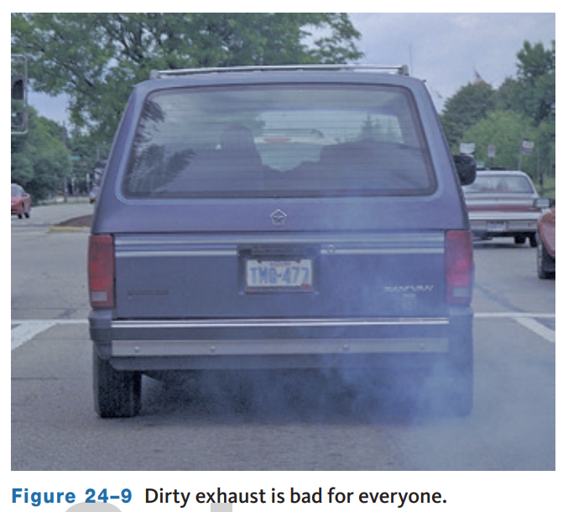
Emission Control Systems
24.03 Explain the purpose of the emission control system.
Emission controls have one purpose and that is to reduce the amount of pollutants and environmentally damaging substances released by vehicles.
The consequences of the pollutants are grievous.
The air we breathe and water we drink have become contaminated with chemicals that adversely affect our health
There are three main automotive pollutants: HC, carbon monoxide (CO), and NOx .
Particulate (soot) emissions are also present in diesel engine exhaust.

Slide 12
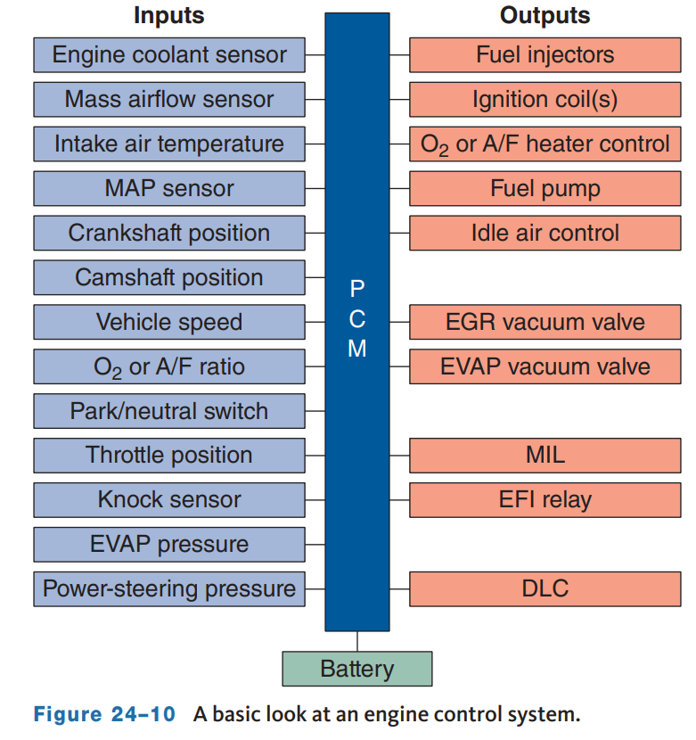
Engine Control Systems
24.04 Describe how computer systems use inputs and outputs for engine control.
The computer is an engine control system that functions like other computers.
It receives inputs, processes information, and commands an output.
The primary computer in an engine control system is the engine control module (ECM) or the powertrain control module (PCM).
The engine control system relies on sensors that convert engine operating conditions such as temperature, engine and vehicle speeds, throttle position, and other conditions into electrical signals that are constantly monitored by the PCM.

Slide 13
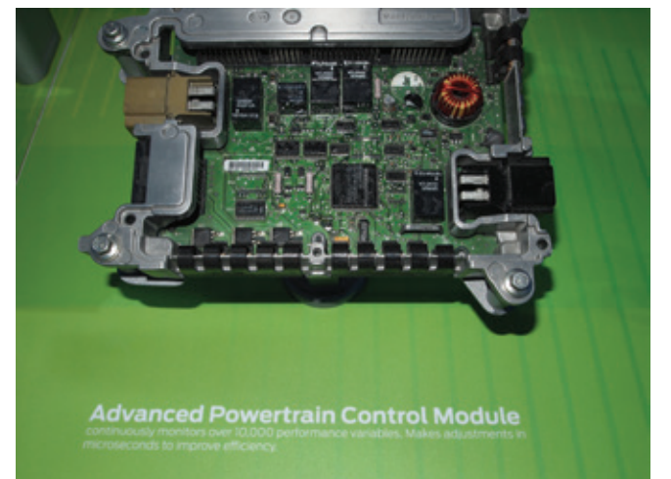
System Components
The sensors, actuators, and computer communicate by electronic and multiplexed circuits.
In a PCM, RAM is used to store data collected by the sensors, the results of calculations, and other information that is constantly changing during engine operation.
Information in volatile RAM is erased when the ignition is turned off or when the power is disconnected.
Nonvolatile RAM does not lose its data if its power source is disconnected.
The computer’s permanent memory is stored in ROM or PROM and is not erased when the power source is disconnected.

Slide 14
Control of Non-Engine Functions
24.05 Describe how the computer system is used to control non-engine-related functions.
Some devices that are not directly connected to the engine are also controlled by the PCM to ensure maximum efficiency.
On some vehicles, the torque converter lock-up clutch is applied and released by a signal from the computer.
The clutch is applied by transmission hydraulic pressure, which is controlled by electrical solenoids that are in turn controlled by the computer.
In most cases, the PCM works with other control modules to control a system.
  Examples of these are antilock brake systems, traction and stability control systems, and other accessories.

Slide 15
On-Board Diagnostic Systems
24.06 Explain the purpose of Onboard Diagnostic Systems.
24.07 Describe OBD II operation.
24.08 Briefly describe the monitored systems in an OBD II system.
Because all manufacturers have continually updated, expanded, and improved their computerized control systems, there are hundreds of different domestic and import systems on the road.
OBD II called for all vehicles to use the same terms, acronyms, and definitions to describe their components.
They also have the same type of diagnostic connector, the same basic test sequences, and display the same trouble codes.
OBD II has been on all vehicles sold in North America since 1997.
The primary goal of OBD systems is to reduce vehicle emissions and reduce the possibility of future emission increases by detecting and reporting system malfunctions.

Slide 16
OBD I (Generation 1)
24.08 Briefly describe the monitored systems in an OBD II system.
24.09 Describe the self-diagnostic capabilities of OBD II. Define the MIL and what types of data are available. Diagnose the causes of emissions or driveability concerns resulting from malfunctions in the computerized engine control system with stored diagnostic trouble codes.
OBD I systems were first used in 1988.
The ECM was capable of monitoring critical emission-related parts and systems and illuminating a malfunction indicator if a defect was found.
The malfunction indicator lamp (MIL) was in the instrument panel.
Most OBD I systems used flash codes to display DTCs.
The codes were displayed with the MIL.
Often, the codes were displayed by jumping across terminals at a diagnostic data link connector (DLC).
Manufacturers provided lists of what the codes represented, along with step-by-step diagnostic procedures for identifying the exact fault.

Slide 17
OBD II (Generation 2)
OBD II was established to overcome some of the weaknesses of OBD I.
OBD I systems monitored only a few emission-related parts and were not set to maintain a specific level of emissions.
OBD II was developed to be a more comprehensive monitoring system and to allow more accurate diagnosis by technicians.
OBD II systems are designed to ensure that vehicles remain as clean as possible over their entire life.
During an emissions or “smog” check, an inspection computer can be plugged into the DLC of the vehicle and read the data from the vehicle’s computer.
OBD II added monitor functions for such things as catalyst efficiency, engine misfire detection, evaporative system, secondary air system, and EGR system flow rate.
  These monitors detect problems that would affect emissions levels.
Also, a serial data stream of 20 basic data parameters and common DTCs was adopted.

Slide 18
OBD III (Generation 3)
The main goal of OBD III is to minimize the delay between the detection of an emissions failure by the OBD II system and the actual repair of the vehicle.
It has been said that the check engine light is a poor motivator for prompt repair, and many repairs to the emissions-related parts of vehicles are being delayed until the mandatory emissions inspection is approaching.
Once the vehicle’s emission data is collected, the vehicle’s owner will be notified about the results.
If a fault is present that increases emission, the owner will be given a certain amount of time to have the problem corrected and the vehicle retested.
This type of vehicle monitoring has raised some fear in car owners.
They feel that the government will be able to know too much and want their privacy protected.
For this reason, the final design and method for OBD III have not been decided.

Slide 19
System Operation
Open-Loop Mode
  When the engine, oxygen sensors, and catalytic converter are cold, most electronic engine controls go into open-loop mode.
  In this mode, the control loop is not a complete cycle and the computer does not react to feedback information from the oxygen sensors. Instead, the computer makes decisions based on preprogrammed information that allows it to make basic ignition or air–fuel settings based on coolant temperature, throttle position, and other inputs.
Closed-Loop Mode
  During the closed-loop mode, the PCM receives and processes all information available. Sensor inputs are sent to the PCM; the PCM compares those values to its programs, and then sends commands to the output devices.
  The output devices adjust ignition timing, air–fuel ratio, and emission control operation. The resulting engine operation will result from the new inputs from the sensors.

Slide 20
Knowledge Check (1 of 2)
What sensor(s) is ignored during open loop, but included in the PCM calculation during closed loop?

Slide 21
Knowledge Check Answer (1 of 2)
  Answer: The oxygen sensors.

Slide 22
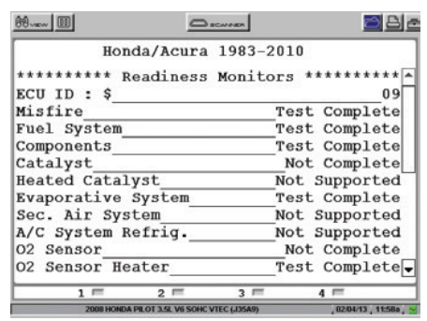
OBD II Monitoring Capabilities
OBD II monitors the performance of emission and other related systems.
The purpose of these monitors is to detect failing systems and not wait until they fail before illuminating the MIL.
OBD II systems will perform certain tests on various subsystems of the engine management system.
If one or more monitored systems are found to have a malfunction, the MIL will illuminate to alert the driver of a problem.
Some monitors run continuously, whereas others will run only when certain operating conditions are present during the drive cycle.
These conditions are called the enable criteria.

Slide 23
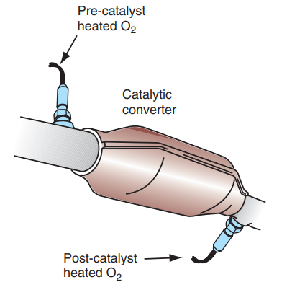
Catalyst Efficiency Monitor
OBD II vehicles use a minimum of two oxygen sensors.
One of these is used for feedback to the PCM for fuel control, and the other, located at the rear of the catalytic converter, gives an indication of the efficiency of the converter and may also be used for fuel control.
The downstream O₂ sensor is sometimes called the “catalyst monitor sensor” (CMS).
The catalyst efficiency monitor compares the signals between the two O₂ sensors to determine how well the catalyst is working.
One heated O₂ sensor (HO₂S) is mounted near the exhaust manifold, and the additional HO₂S is mounted downstream from the catalytic

Slide 24
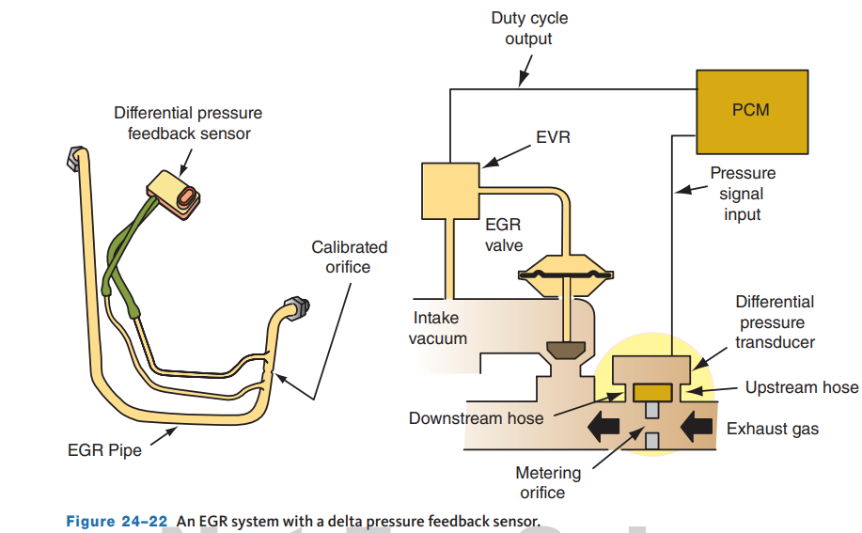
EGR System Monitoring
The EGR monitors use different strategies to determine if the system is operating properly.
Some monitor the temperature within the EGR passages.
Other systems look at the MAP signal, energize the EGR valve, and look for corresponding change in vacuum levels.
Some systems open the EGR during coast down and monitor the change in STFT.
There are many different EGR systems used today.
The pressure feedback EGR, linear EGR, and delta pressure feedback EGR systems are the most common.

Slide 25
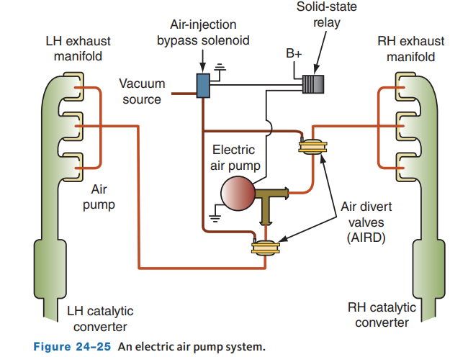
Secondary Air Injection (AIR) System Monitor
The AIR system operation can be verified by turning the system on to inject air upstream of the O₂ sensor while monitoring its signal.
On some vehicles, the AIR system is monitored with passive and active tests.
If the AIR system fails the passive test or if the test is inconclusive, the AIR monitor in the PCM proceeds with the active test.
The secondary AIR system monitor illuminates the MIL and stores a DTC in the PCM’s memory if the AIR system fails the active test on two consecutive trips.
Some vehicles have an electric air pump system.
In this system, the air pump is controlled by a solid-state relay.
The relay is operated by a signal from the PCM.

Slide 26
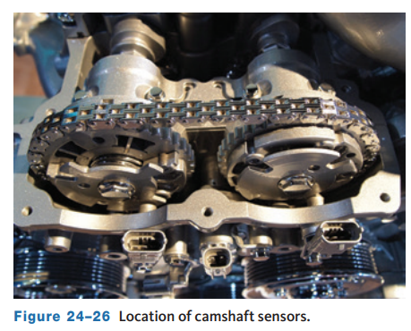
Variable Cam Timing System Monitor
Late-model vehicles equipped with variable valve timing (VVT) use a monitor that checks system operation.
Because VVT systems are often used for EGR purposes, the operation of the VVT can directly affect exhaust emissions.
The monitor examines the response time for the camshaft position to change based on VVT command and camshaft position measured by the CMP sensor.
If the response rate is slow, a DTC will set for VVT performance.

Slide 27
Discussion
OBD II monitors the performance of emission and other related systems.
Have a class discussion while providing several examples of emissions systems and an overall view of how each of these systems of devices is monitored.

Slide 28
OBD II Self-Diagnostics (1 of 3)
MIL
  According to OBD II regulations, the PCM must illuminate the MIL when it detects a problem that affects emissions.
  Also, when a malfunction is detected, a DTC must be set.
  Depending on the problem, the MIL will either light and stay on or it will blink.
  The action of the MIL depends on the monitor and the problem.
  For example, a misfire that would allow emissions to exceed regulations but not damage the catalyst will light the MIL.
  If the misfire will raise the catalytic converter’s temperature enough to destroy it, the MIL will blink.
  The MIL will be turned off if the misfire did not occur during three consecutive drive cycles.
  This requirement is true for most monitors.

Slide 29
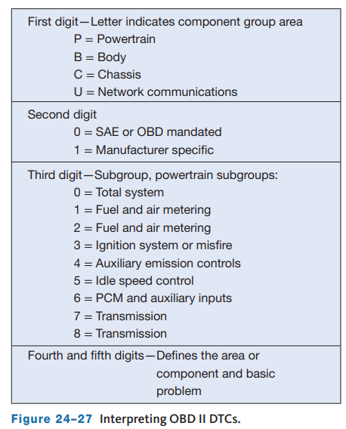
OBD II Self-Diagnostics (2 of 3)
Diagnostic Trouble Codes
  Generic OBD II codes are standardized, which means that most DTCs mean the same thing regardless of the vehicle.
  DTCs are designed to indicate the circuit and the system where a fault has been detected.
  An OBD II DTC is a five-character code with both letters and numbers.
  This is called the alphanumeric system.
  The first character of the code is a letter.
  This defines the system where the code was set. Currently there are four possible first character codes: “B” for body, “C” for chassis, “P” for powertrain, and “U” originally for undefined.

Slide 30
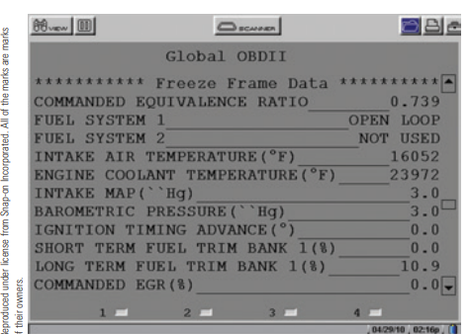
OBD II Self-Diagnostics (3 of 3)
Freeze Frame Data
  One of the mandated capabilities of OBD II is the “freeze frame” or snapshot feature.
  With this feature, the PCM takes a snapshot of the activity of the various inputs and outputs at the time the PCM illuminated the MIL.
  The PCM uses this data for identification and comparison of similar operating conditions if the same problem occurs in the future.
  This feature is also valuable to technicians, especially when trying to identify the cause of an intermittent problem.
  The action of sensors and actuators when the code was set can be reviewed.

Slide 31
Basic Diagnosis of Electronic Engine Control Systems (1 of 2)
Logical Diagnosis
  When faced with an abnormal engine condition, the best automotive technicians compare clues (such as scan tool data, meter readings) with their knowledge of proper conditions and discover a logical reason for the way the engine is performing.
  Logical diagnosis means following a simple basic procedure.
  Start with the most likely cause and work to the most unlikely.
  Do not guess at the problem before considering all the factors.
  The logical approach has a special application to troubleshooting electronic engine controls.
  Always check all traditional nonelectronic engine control possibilities before attempting to diagnose the electronic engine control system.

Slide 32
Basic Diagnosis of Electronic Engine Control Systems (2 of 2)
Repair Information
  All late-model engine controls have self-diagnosis capabilities.
  A malfunction in any sensor, output device, or in the computer itself is stored as a DTC.
  DTCs are retrieved and the indicated problem areas checked further.
  Correct diagnosis depends on correctly interpreting all data collected and performing all subsequent tests properly.
  The following are a few of the service information that will help:
    Instructions for retrieving DTCs and obtaining freeze frames
    Instructions for diagnosing a no communication problem between the system and the scan tool
    Current technical bulletins for the vehicle

Slide 33
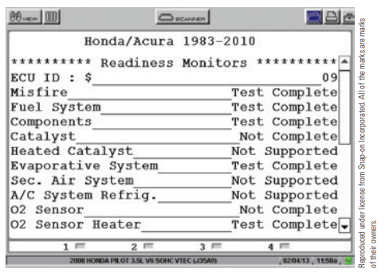
Diagnosing OBD II Systems
All OBD II scan tools include a readiness function that shows all of the monitoring sequences and the status of each: complete or incomplete.
Some systems may show the monitors as ready or not-ready.
Incomplete can mean the monitor did not complete, judgment is withheld pending further testing, the monitor did not operate, or the monitor operated and recorded a failure.
The “Readiness Test” and “Monitor Status” screens on most scan tools contain identical information.
Readiness monitor tools are available.

Slide 34
Parameter Identifications
Parameter identification codes, usually called PIDs, identify which pieces of data the scan tool is requesting.
When a scan tool is connected to the DLC and serial data is displayed, the scan tool is asking the computer to see sensor data that is categorized by the parameter ID.
For example, when you use the scan tool to observe engine coolant temperature sensor data, the scan tool requests data from Mode $01 PID 5.
Regardless of what scan tool is used on an OBD II equipped vehicle, requesting generic data from Mode $01 PID 5 will show ECT data.
The list of PIDs is standardized and has been updated since the introduction of OBD II.
Generic PIDs can be accessed by any type of scan tool or code reader with generic functions.
To access enhanced or manufacturer PIDs requires using either an enhanced or manufacturer’s scan tool.
Because of these two separate sets of PIDs, not all data is available on a generic scan tool using Mode $01.

Slide 35
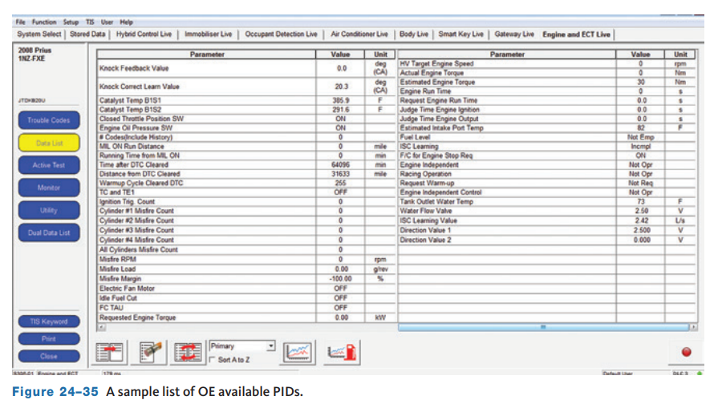
Serial Data
PIDs are codes used to request data from a PCM.
A scan tool is used for the request and receipt of the serial data.
To do this, the desired PID is requested by the scan tool.
The device connected to the CAN bus that is responsible for this PID reports the value for that PID back to the bus and is read on the scan tool.
Many PIDs are standard for all OBD II systems.
  However, not all vehicles will support all PIDs, and there are manufacturer defined PIDs that are not part of the OBD II standard.

Slide 36
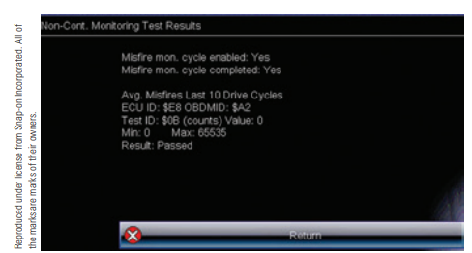
Using Mode 6
Mode 6 allows access to the results of various monitor diagnostic tests.
The test values are stored at the time each monitor is completed.
The information available in Mode 6 can be extremely helpful, but it also can be very difficult to decipher.
Mode 6 data is given with $ signs, test IDs (TIDs), and content IDs (CIDs) and a mixture of letters and numbers. Most of this has no face value because it is given in “hexadecimals,” which is foreign language.
The way to observe Mode 6 data on a scan tool varies with the make and model of the tool.

Slide 37
Repairing the System
When servicing or repairing OBD II circuits, here are some of the following guidelines:
  Do not connect aftermarket accessories into an OBD II circuit or network.
  Do not move or alter grounds from their original locations.
  Always replace a relay with an exact replacement. Damaged relays should be thrown away, not repaired.
  Make sure all connector locks are in good condition and are in place.
After repairs, the system should be rechecked to verify that the repair took care of the problem.
  This may involve road testing the vehicle to verify that the complaint has been resolved.

Slide 38
Knowledge Check (2 of 2)
If a technician wanted to view serial data, what menu option would be selected on the scan tool?

Slide 39
Knowledge Check Answer (2 of 2)
The serial data menu. Commonly called live data.

Slide 40
Chapter Reflection
Please take a moment to compare consider the engine performance concepts learned in this chapter. Then respond to the following questions in one or two paragraphs. Use 150–200 words in your reflection.
Do you feel you understand all of the concepts described in this chapter? What actions can you take to better understand them.
Considering all you have learned, do you feel you are prepared to perform engine performance system service in a shop or lab setting? How can you become more prepared?

